Slide 1
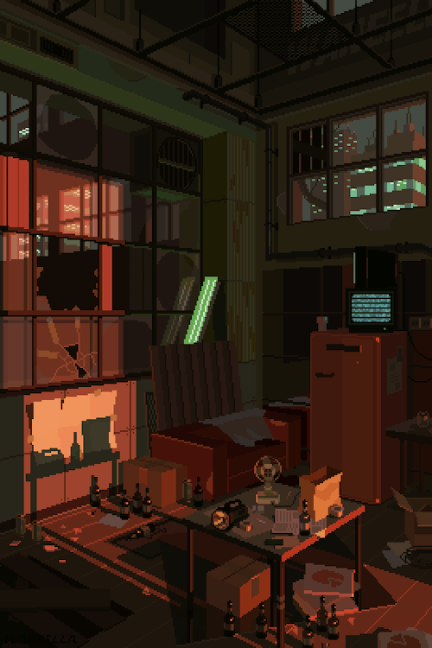
Security Researchers
Winter 2017 Meetup // BrewDog // Grünerløkka @BD57Bar #BrewSec
(Quiz: install kahoot app or make sure you can access https://kahoot.it)
waneella.tumblr.com

Slide 2
Practicalities
Hello My Name Is Aune – Double IPA | 8.2% | 3.59
Slot Machine – Rye IPA | 6.2% | 3.51
AB:23 – Barleywine | 11.5% | 4.00
Punk IPA -- IPA | 5.6% | 3.22
Nine To Five Wizard – White IPA | 7.5% | 3.38
Vagabond – Gluten Free | 4.7% | 3.48
Santa Paws – Scottish Ale | 4.5% | 3.30
5 A.M. Saint – Red Ale | 5% | 3.67
Cocoa Psyco – Stout | 10% | 3.96
Håndverkspils – Pilsner | 4.7% | 3.39
Gjertruds Vintervarmer – Doppelbock | 9% | 3.71
Quorum – Brown Ale | 5.5% | 3.58
Rhodesian – Barleywine | 11.3% | 3.78
Amalgamation – Belgian Tripel | 8% | 3.82
Baby Snake – Sour | 5.2% | 3.24
L'ours Noir – American Wild Ale | 6% | 3.61
Märzen Oktoberfest – Marzen | 4.7% | 3.18
Rett I Nebbet – Double IPA | 8% | 3.80
Sawa Sawa – Sour | 4.1% | 3.50
Ingefær III – Ginger | 5.2% | 3.29
Saison D'Epeautre – Saison | 6% | 3.70
Bathrooms are near the entrance and also downstairs
Three talks with short Q&A
Quiz in-between each talk
(install kahoot app or make sure you can access https://kahoot.it)
Need beer/drink bonger? See Einar

Slide 3
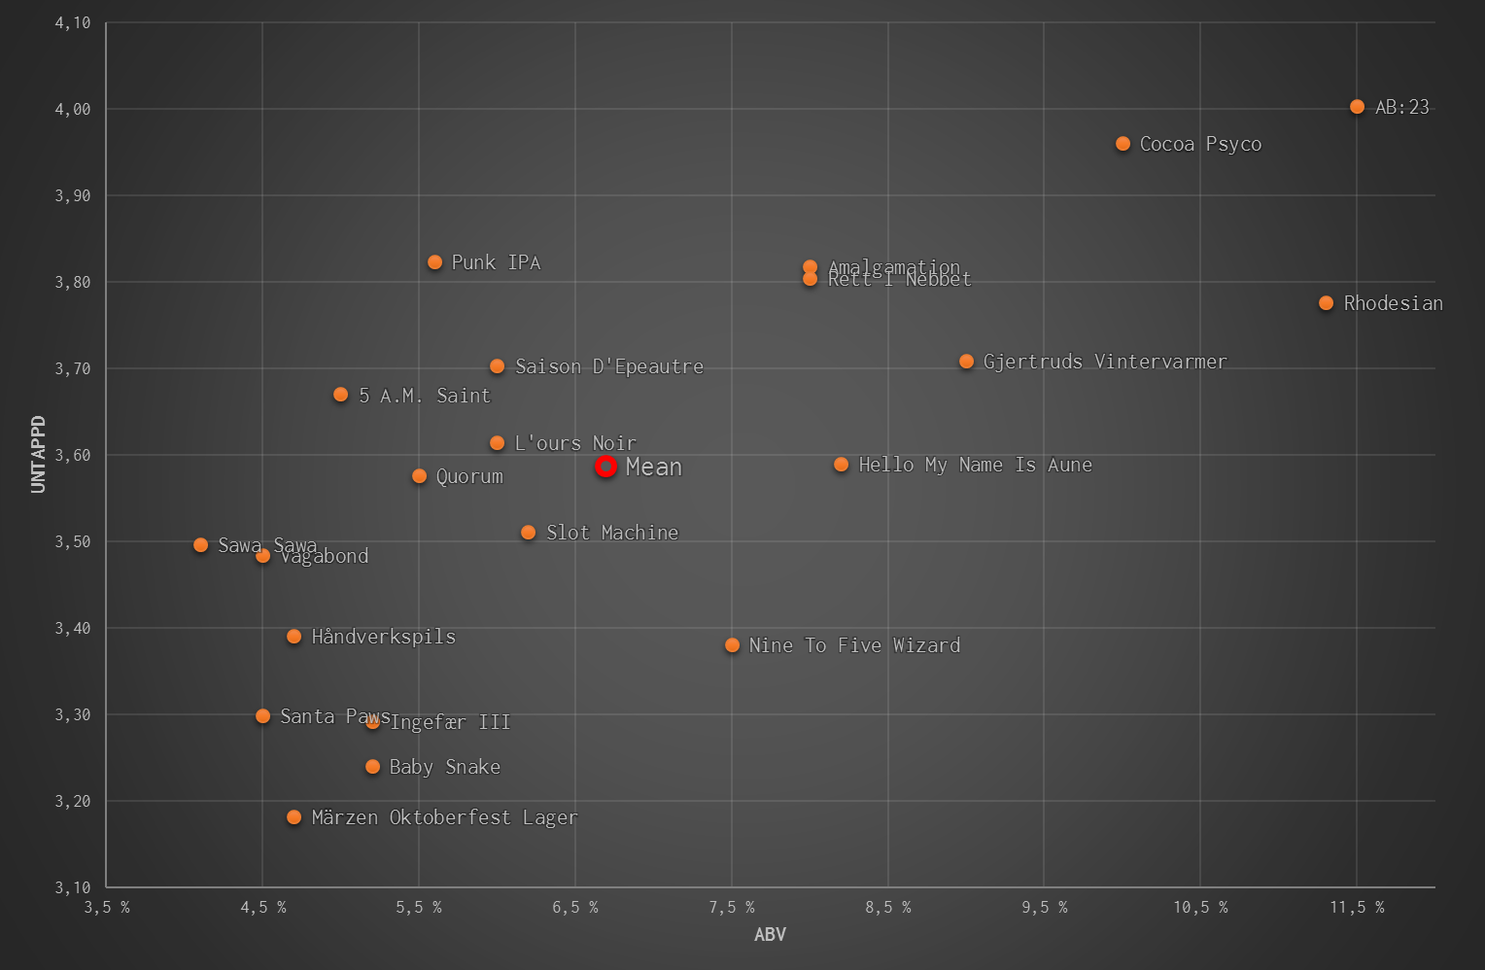

Slide 4
$ whoami
Jonathan Camp – Symantec Norway keybase.io/kung_foo – 8F1F B151 D565 3923 secure@jonathan.camp (ProtonMail)

Slide 5
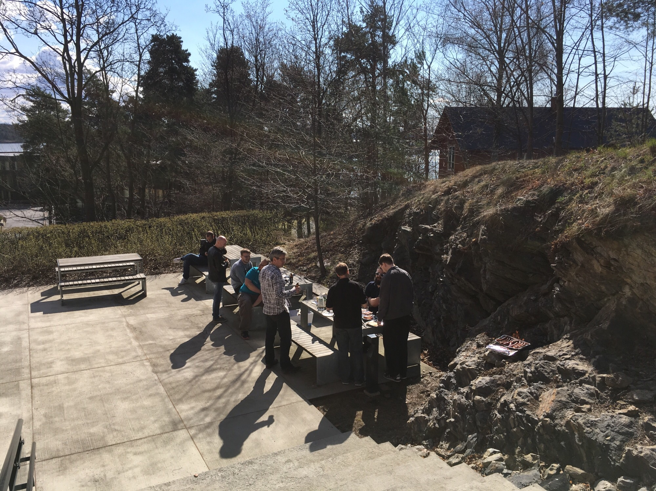
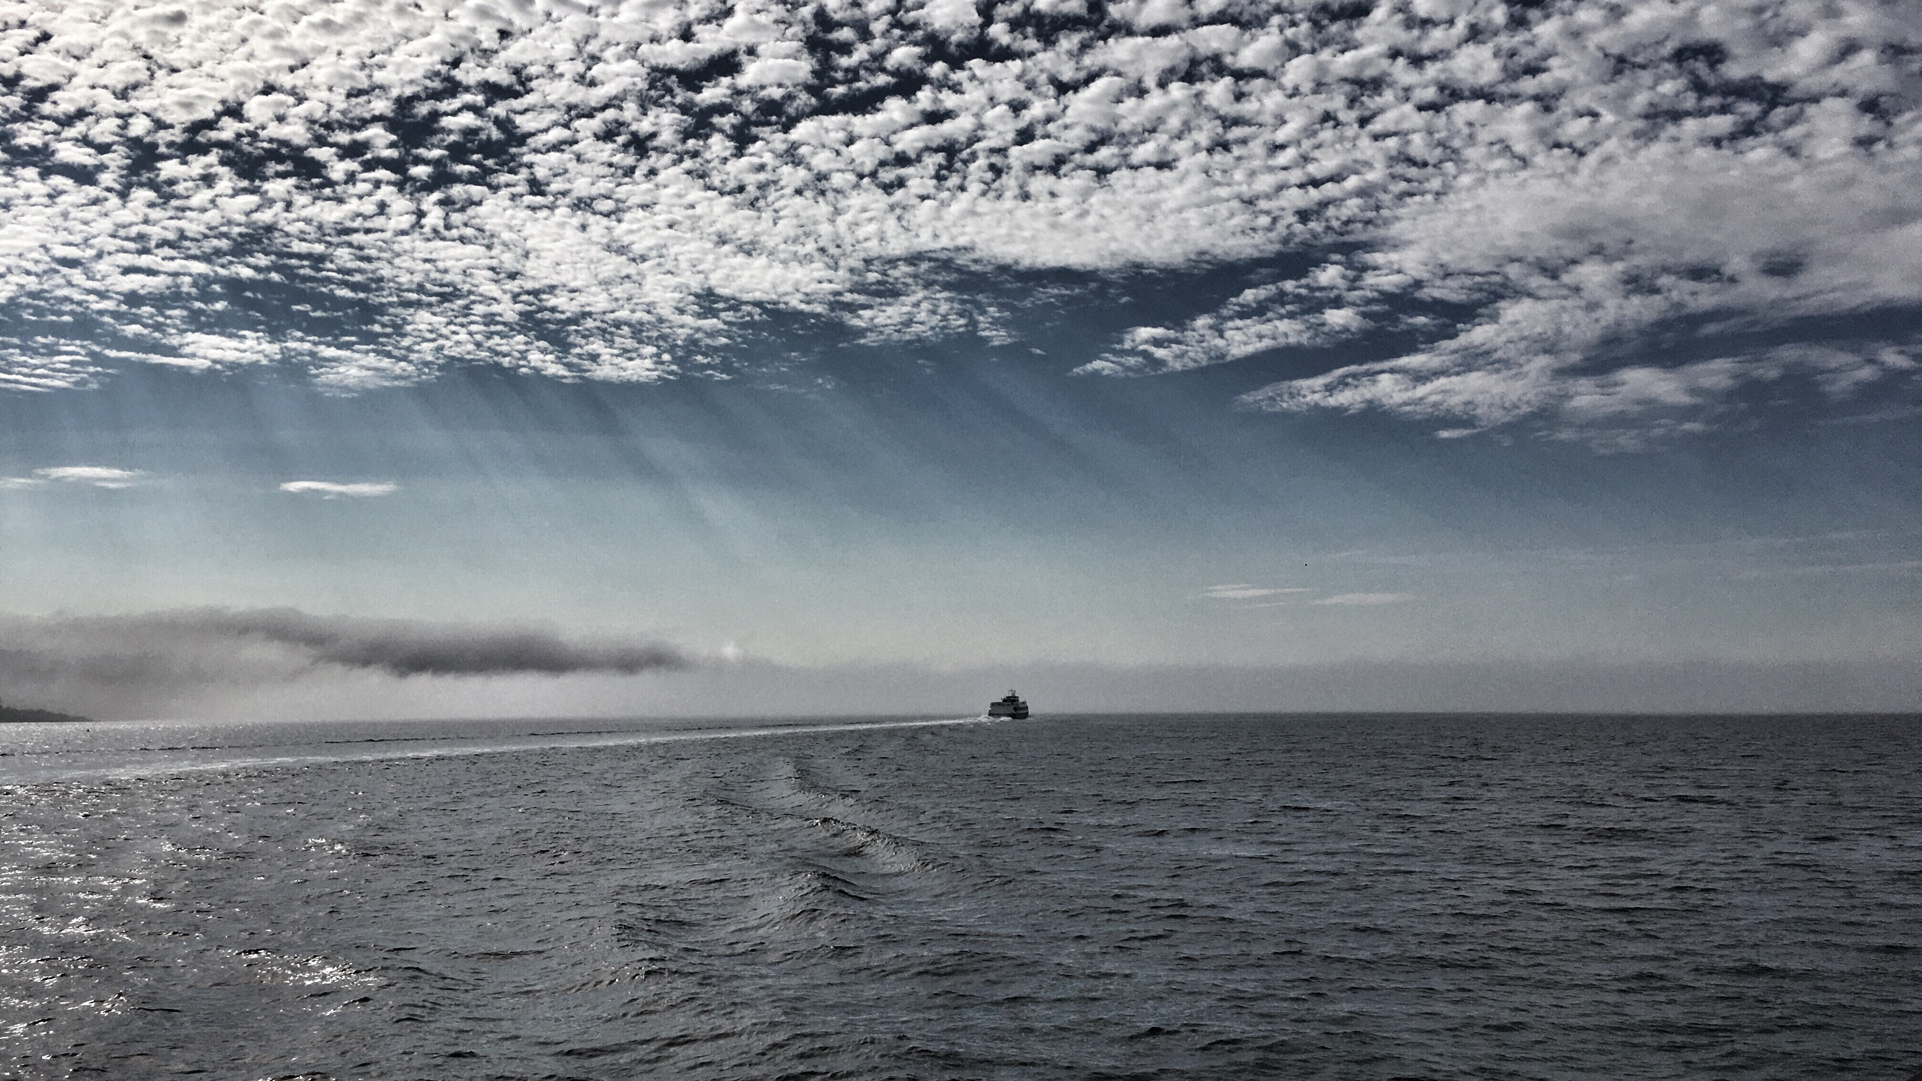

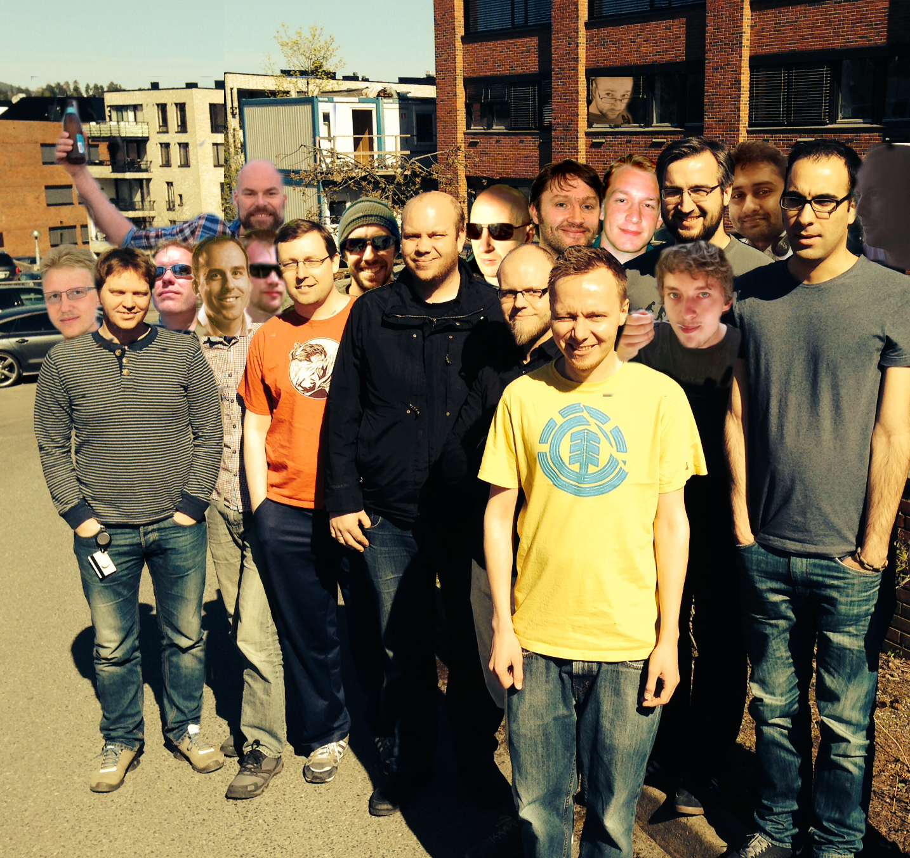

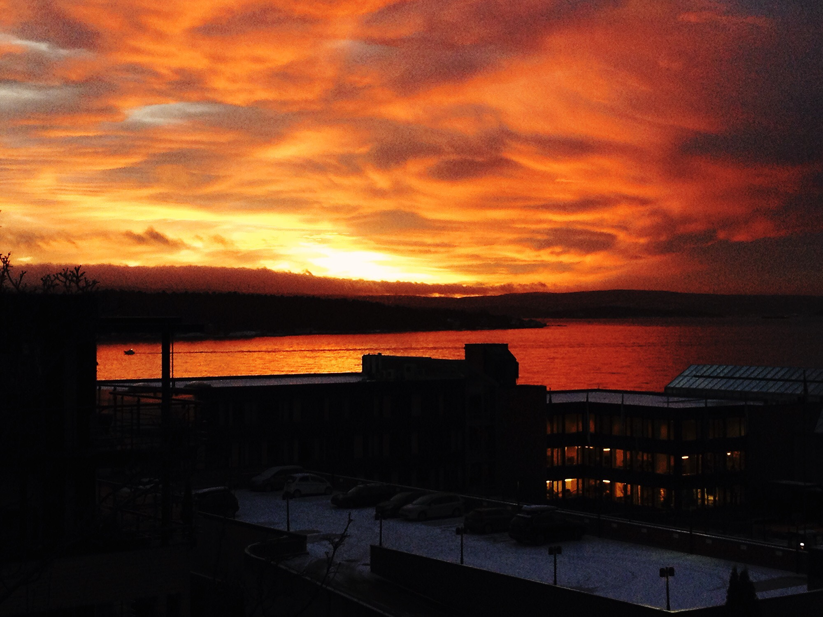
Note from our sponsors…
OS X / iOS reversing?
Malware at scale?
Analytics at scale?
Love Lysaker Brygge?
Python, C/C++, Node.js, golang, AWS::*, Terraform, SaltStack, QEMU/KVM, radare2, Angular2, IDA/Hex-Rays, Docker, Kubernetes, Redis, beer, ElasticSearch
PHP…

Slide 6
Schedule
Competing in the European Cyber Security Challenge // Martin Ingesen // @Mrtn9
When Private is Public // Ryan Mattinson //@rmattinson
10 minute break
Quiz #1
Hypervisor Debugging with radare2 // Lars Haukli // @zutle
10 minute break
Quiz #2
APT32/Ocean Lotus operations in SE Asia // Snorre Fagerland // @fstenv
(Quiz: install kahoot app or make sure you can access https://kahoot.it)

Slide 7
Quiz!
Rules
The quiz master is always right
If the quiz master is wrong, goto 1
Goto https://kahoot.it and enter code
Multiple choice (4)
Can be more than one correct answer
Faster response == more points
Two 15 question rounds
Prize for top player in each round *

Slide 8
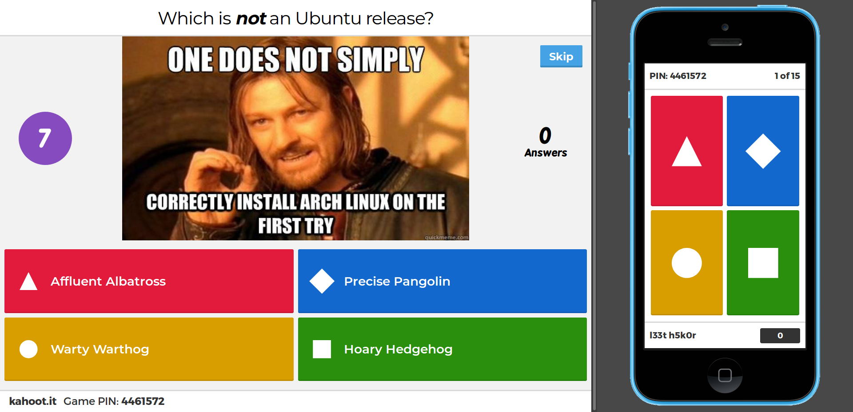

Slide 9
postscript
Special thanks to:
{Mona Daae | Einar Oftedal} @ Symantec Norway
BrewDog
Martin, Ryan, Lars, Snorre

Slide 10
Postscript2
Follow Up, Feedback & Flames:
https://www.meetup.com/Security-Researchers/events/244875828/
Documents:
https://github.com/s55-labs/security-researchers-meetup-oslo
Quizes:
https://play.kahoot.it/#/?quizId=bcc1f58a-7421-4c5e-8871-416f53da2133
https://play.kahoot.it/#/?quizId=98f48c71-fd42-4180-94e4-2e6d8df36486
Next Steps:
Spring Meetup
Speakers and Ideas
Contact: Jonathan or Einar

Slide 11
Thanks!
Hello My Name Is Aune – Double IPA | 8.2% | 3.59
Slot Machine – Rye IPA | 6.2% | 3.51
AB:23 – Barleywine | 11.5% | 4.00
Punk IPA -- IPA | 5.6% | 3.22
Nine To Five Wizard – White IPA | 7.5% | 3.38
Vagabond – Gluten Free | 4.7% | 3.48
Santa Paws – Scottish Ale | 4.5% | 3.30
5 A.M. Saint – Red Ale | 5% | 3.67
Cocoa Psyco – Stout | 10% | 3.96
Håndverkspils – Pilsner | 4.7% | 3.39
Gjertruds Vintervarmer – Doppelbock | 9% | 3.71
Quorum – Brown Ale | 5.5% | 3.58
Rhodesian – Barleywine | 11.3% | 3.78
Amalgamation – Belgian Tripel | 8% | 3.82
Baby Snake – Sour | 5.2% | 3.24
L'ours Noir – American Wild Ale | 6% | 3.61
Märzen Oktoberfest – Marzen | 4.7% | 3.18
Rett I Nebbet – Double IPA | 8% | 3.80
Sawa Sawa – Sour | 4.1% | 3.50
Ingefær III – Ginger | 5.2% | 3.29
Saison D'Epeautre – Saison | 6% | 3.70
Bar Closes At ???

